Slide 1


A Content-Based Song Recommender for Spotify
J. Garrecht Metzger, PhD
Notes:
here to talk about capstone project at Metis Data Science bootcamp

Slide 2


J. Garrecht Metzger
PhD Geochemist
Notes:
*PhD at WashU studying Ordovician Biogeochemical Carbon Cycle.

Slide 3



J. Garrecht Metzger
PhD Geochemist
Farmer
Quack
Notes:
*Boutique duck farm
*NorCal
-Farm to table
-Designed and rebuilt water systems 3 ranches
-Seen 1st season of MythBusters

Slide 4


J. Garrecht Metzger
PhD Geochemist
Farmer
Musician
Notes:
*Avid musician for coming up on 20 years
-Interest in guitar pedals and electronics got me interested in coding
-sought out data science to combine interests

Slide 5

J. Garrecht Metzger
PhD Geochemist
Farmer
Musician
Data Scientist
Data Scientist
Notes:
*Bring me to today
*Most recently a Metis Bootcamp survivor.

Slide 6
What is Spotify?

Slide 7
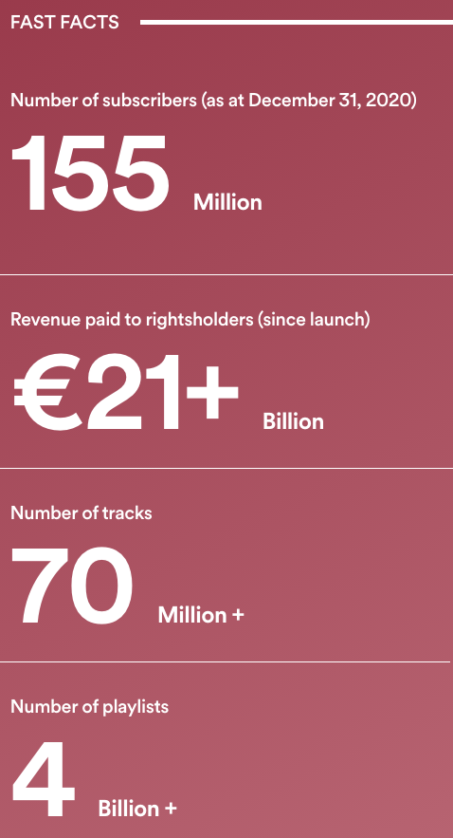
What is Spotify?
Notes:
If you don’t know Spotify is an audio streaming juggernaut and boasts about having a library of over 70million tracks
Prominant feature is the playlists, namely recommended ones
Radio for artists, tracks

Slide 8
What is Spotify?
Notes:
If you don’t know Spotify is an audio streaming juggernaut and boasts about having a library of over 70million tracks
Prominant feature is the playlists, namely recommended ones
Radio for artists, tracks

Slide 9
What is Spotify?
That’s a lot of material to recommend from!
Notes:
If you don’t know Spotify is an audio streaming juggernaut and boasts about having a library of over 70million tracks
Prominant feature is the playlists, namely recommended ones
Radio for artists, tracks

Slide 10
What is Spotify?
That’s a lot of material to recommend from!
Notes:
If you don’t know Spotify is an audio streaming juggernaut and boasts about having a library of over 70million tracks
Prominant feature is the playlists, namely recommended ones
Radio for artists, tracks

Slide 11
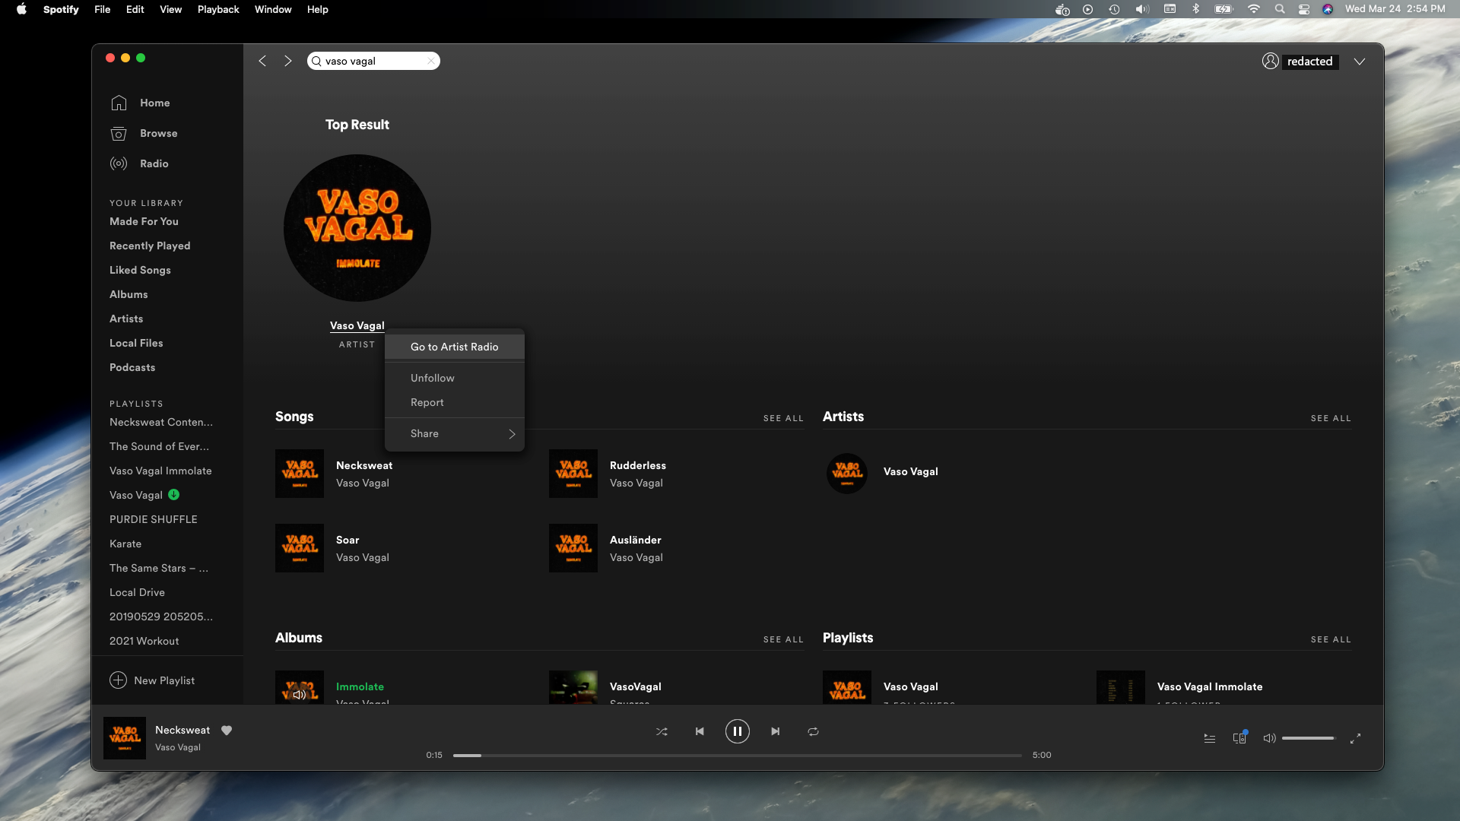

Slide 13
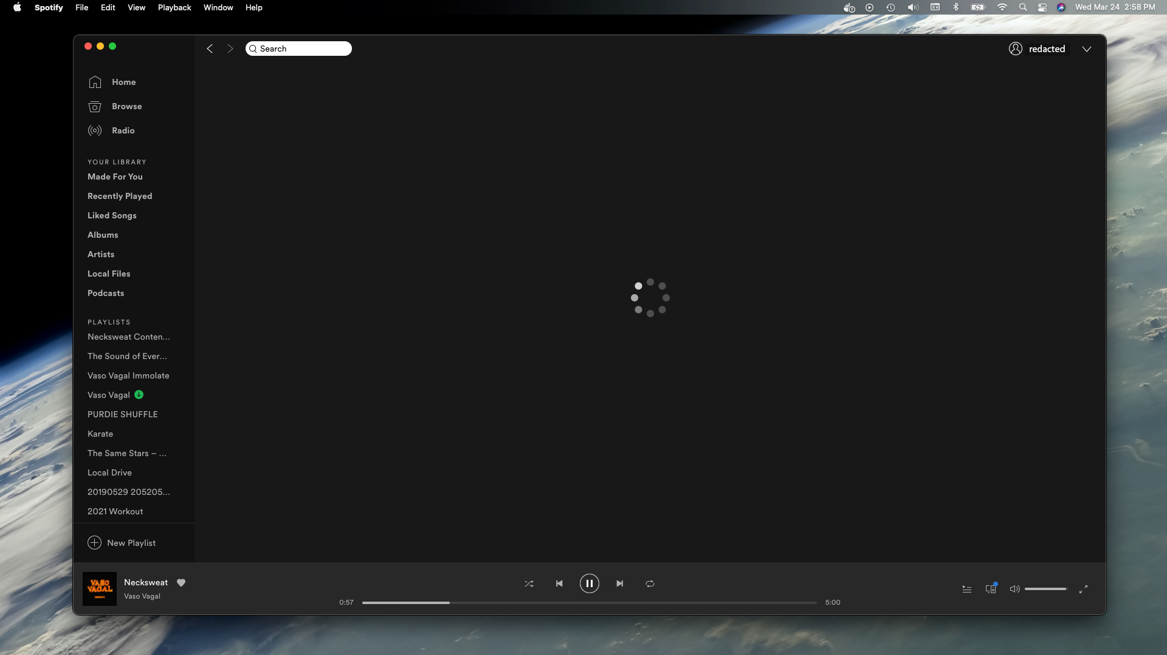
Notes:
SLOW DOWN
EXPLAIN PROBLEM

Slide 14
Wheel of Doom
Notes:
Intereseting, so what is going on?

Slide 15
Motivation
Notes:
This helps set up our motivation:

Slide 16
Motivation
Spotify uses an ‘ensemble’ recommender
Notes:
To get something we don’t have.

Slide 17
Motivation
Spotify uses an ‘ensemble’ recommender
Includes audio + user content (‘likes’)
Notes:
To get something we don’t have.

Slide 18
Motivation
Spotify uses an ‘ensemble’ recommender
Includes audio + user content (‘likes’)
User control is limited and indirect
Notes:
To get something we don’t have.

Slide 19
Motivation
Spotify uses an ‘ensemble’ recommender
Includes audio + user content (‘likes’)
User control is limited and indirect
Small artists are excluded from the recommendation system
Notes:
To get something we don’t have.

Slide 20
Motivation
Spotify uses an ‘ensemble’ recommender
Includes audio + user content (‘likes’)
User control is limited and indirect
Small artists are excluded from the recommendation system
A more general recommender
Notes:
To get something we don’t have.

Slide 21
Motivation
Spotify uses an ‘ensemble’ recommender
Includes audio + user content (‘likes’)
User control is limited and indirect
Small artists are excluded from the recommendation system
A more general recommender
Based on audio content
Notes:
To get something we don’t have.

Slide 22
Motivation
Spotify uses an ‘ensemble’ recommender
Includes audio + user content (‘likes’)
User control is limited and indirect
Small artists are excluded from the recommendation system
A more general recommender
Based on audio content
Customizable feature selection
Notes:
To get something we don’t have.

Slide 23
Motivation
Spotify uses an ‘ensemble’ recommender
Includes audio + user content (‘likes’)
User control is limited and indirect
Small artists are excluded from the recommendation system
A more general recommender
Based on audio content
Customizable feature selection
A song recommender for everyone!

Slide 24
Problem: Data Selection

Slide 25
Problem: Data Selection
>70,000,000,000 tracks!

Slide 26
Problem: Data Selection
>70,000,000,000 tracks!
Computationally prohibitive

Slide 27
Problem: Data Selection
>70,000,000,000 tracks!
Computationally prohibitive
No random sampling possible

Slide 28
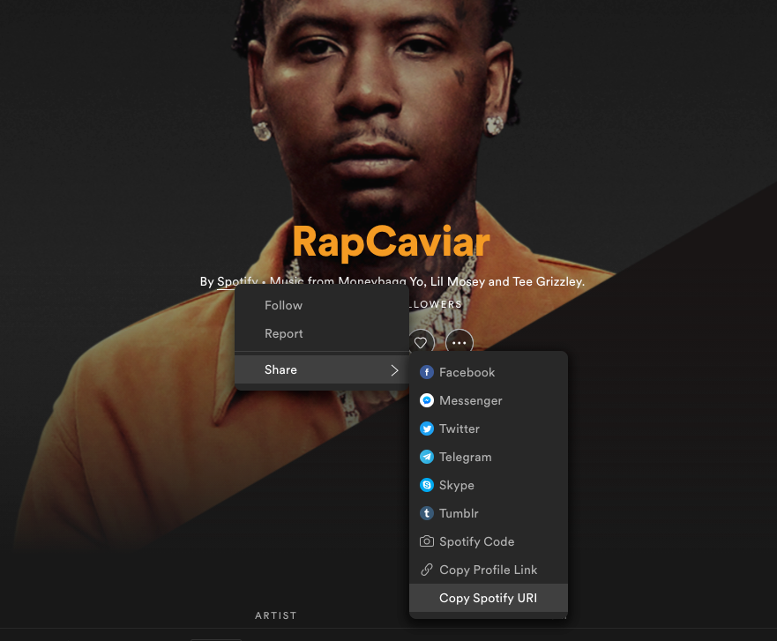
Problem: Data Selection
>70,000,000,000 tracks!
Computationally prohibitive
No random sampling possible
Big ‘get’ was finding the official user account

Slide 29
Problem: Data Selection
>70,000,000,000 tracks!
Computationally prohibitive
No random sampling possible
Big ‘get’ was finding the official user account
‘hiding in plain sight’.
Notes:
~100-150 playlists
API

Slide 30
API Results
Official ‘spotify’ user account

Slide 31
API Results
Official ‘spotify’ user account
1,398 Playlists

Slide 32
API Results
Official ‘spotify’ user account
1,398 Playlists
81,648 Tracks

Slide 33
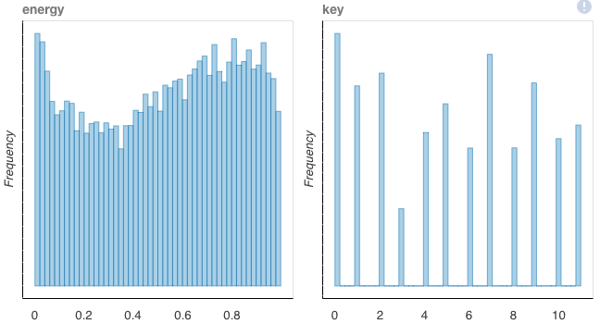
API Results
Official ‘spotify’ user account
1,398 Playlists
81,648 Tracks
Audio content ‘features’

Slide 34
API Results
Official ‘spotify’ user account
1,398 Playlists
81,648 Tracks
Add any songs available on Spotify
Audio content ‘features’

Slide 35
API Results
Official ‘spotify’ user account
1,398 Playlists
81,648 Tracks
Add any songs available on Spotify
Allows direct connection between small artists and bigger ones
Audio content ‘features’

Slide 36
Track Data
Metadata
Track Name
Album Name
Artist
Release Date
Artwork

Slide 37

Track Data
Metadata
Track Name
Album Name
Artist
Release Date
Artwork
Artist
Album Name

Slide 38
Audio Content Features
Subjective (0 – 1)

Slide 39
Audio Content Features
Subjective (0 – 1)
Acousticness
Danceability
Energy
Instrumentalness
Liveness
Speechiness
Valence

Slide 40
Audio Content Features
Objective
Subjective (0 – 1)
Acousticness
Danceability
Energy
Instrumentalness
Liveness
Speechiness
Valence

Slide 41
Audio Content Features
Subjective (0 – 1)
Objective
Acousticness
Danceability
Energy
Instrumentalness
Liveness
Speechiness
Valence
Duration (range, milliseconds)
Key (Western, 12)
Loudness (~ -60 to 0, dB)
Mode (0=minor, 1=major)
Popularity (0-100)
Tempo (0 - ~300)
Time Signature

Slide 42
Examples

Slide 43

Examples
Rihanna: We Found Love
Danceability: 0.74
Energy: 0.77
Tempo: 128

Slide 44

Examples
Rihanna: We Found Love
Danceability: 0.74
Energy: 0.77
Tempo: 128
Vince Guaraldi Trio: Für Elise
Danceability: 0.43
Energy: 0.08
Tempo: 130

Slide 45

Examples
Rihanna: We Found Love
Danceability: 0.74
Energy: 0.77
Tempo: 128
Vince Guaraldi Trio: Für Elise
Danceability: 0.43
Energy: 0.08
Tempo: 130
REM: Shiny Happy People
Danceability: 0.45
Energy: 0.91
Tempo: 125

Slide 46
Examples
Rihanna: We Found Love
Danceability: 0.74
Energy: 0.77
Tempo: 128
Vince Guaraldi Trio: Für Elise
Danceability: 0.43
Energy: 0.08
Tempo: 130
REM: Shiny Happy People
Danceability: 0.45
Energy: 0.91
Tempo: 125
How do we recommend?

Slide 47
Method: Cosine Distance/Similarity
Notes:
Say something like “we are going to recommend song based on ones you like (because you uploaded them into the recommender). We we will look at the audio features of that song and recommend based on the proximity of other songs in the feature space.”

Slide 48
Method: Cosine Distance/Similarity
Audio Feature 2
θ
Audio Feature 1
Notes:
Say something like “we are going to recommend song based on ones you like (because you uploaded them into the recommender). We we will look at the audio features of that song and recommend based on the proximity of other songs in the feature space.”

Slide 49
Method: Cosine Distance/Similarity
Distance Matrix
Audio Feature 2
θ
Audio Feature 1
Notes:
Say something like “we are going to recommend song based on ones you like (because you uploaded them into the recommender). We we will look at the audio features of that song and recommend based on the proximity of other songs in the feature space.”

Slide 50
Method: Cosine Distance/Similarity
Distance Matrix
Filter
Audio Feature 2
θ
Audio Feature 1
Notes:
Say something like “we are going to recommend song based on ones you like (because you uploaded them into the recommender). We we will look at the audio features of that song and recommend based on the proximity of other songs in the feature space.”

Slide 51
Method: Cosine Distance/Similarity
Distance Matrix
Filter
Remove largest values
Audio Feature 2
θ
Audio Feature 1
Notes:
Say something like “we are going to recommend song based on ones you like (because you uploaded them into the recommender). We we will look at the audio features of that song and recommend based on the proximity of other songs in the feature space.”

Slide 52
Method: Cosine Distance/Similarity
Distance Matrix
Filter
Remove largest values
Rapid computation
Audio Feature 2
θ
Audio Feature 1
Notes:
Say something like “we are going to recommend song based on ones you like (because you uploaded them into the recommender). We we will look at the audio features of that song and recommend based on the proximity of other songs in the feature space.”

Slide 53
Method: Cosine Distance/Similarity
Distance Matrix
Filter
Remove largest values
Rapid computation
Audio Feature 2
θ
Audio Feature 1
Let’s hear it!
Notes:
Say something like “we are going to recommend song based on ones you like (because you uploaded them into the recommender). We we will look at the audio features of that song and recommend based on the proximity of other songs in the feature space.”

Slide 54

Top Recommended Tracks
Reference Track

Slide 55
Content-Based Recommender: Closing Thoughts
Notes:
To get something we don’t have.

Slide 56
Content-Based Recommender: Closing Thoughts
Then:
Notes:
To get something we don’t have.

Slide 57
Content-Based Recommender: Closing Thoughts
Then:
Native recommender excludes content
Notes:
To get something we don’t have.

Slide 58
Content-Based Recommender: Closing Thoughts
Then:
Native recommender excludes content
User control is limited
Notes:
To get something we don’t have.

Slide 59
Content-Based Recommender: Closing Thoughts
Then:
Native recommender excludes content
User control is limited
Now:
Notes:
To get something we don’t have.

Slide 60
Content-Based Recommender: Closing Thoughts
Then:
Native recommender excludes content
User control is limited
Now:
Found representative data
Notes:
To get something we don’t have.

Slide 61
Content-Based Recommender: Closing Thoughts
Then:
Native recommender excludes content
User control is limited
Now:
Found representative data
Developed rapid computational framework
Notes:
To get something we don’t have.

Slide 62
Content-Based Recommender: Closing Thoughts
Then:
Native recommender excludes content
User control is limited
Now:
Found representative data
Developed rapid computational framework
Positioned for custom recommender web app
Notes:
To get something we don’t have.

Slide 63

Content-Based Recommender: Closing Thoughts
Then:
Native recommender excludes content
User control is limited
Now:
Found representative data
Developed rapid computational framework
Positioned for custom recommender web app
Direct way to relate content from smaller artists with bigger ones
Radiohead
Notes:
To get something we don’t have.

Slide 64




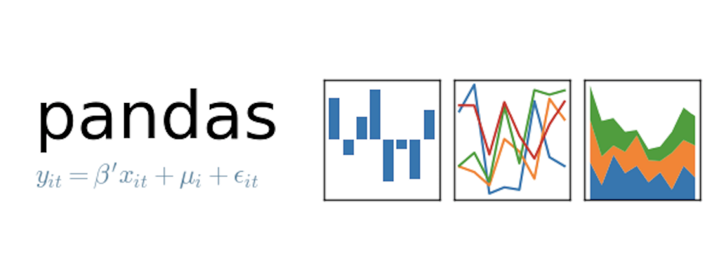
Tools Used
SpotiPy

Slide 65
References
Art: https://www.pixilart.com/art/titanic-sinking-f947f8b9b5c953a
Spotipy: https://github.com/plamere/spotipy/blob/2.17.1/docs/index.rst
Official Spotify Documentation: https://developer.spotify.com/documentation/web-api/reference/#endpoint-get-audio-features
Spotify Facts: https://newsroom.spotify.com/company-info/
Cosine and kmeans figures: Metis lectures

